Slide 1

Enhancing E-Commerce Recommendation
A Tailored Shopping Experience
Dec 8, 2023
Presenters: Jessy Hu, Serena Shi,
Yiwen Song, Jiayi Deng
Notes:
Thank you for joining us today. welcome to our exploration of how to enhance the e-commerce landscape through data-driven personalization.

Slide 2




Meet Our Team
Jessy Hu
Business Intelligence Analyst
jiaqi722@uchicago.edu
Yiwen Song
Data Engineer
ysong64@uchicago.edu
Jiayi Deng
Data Scientist
jiayideng@uchicago.edu
Serena Shi
Data Scientist
yutong0121@uchicago.edu
2
Notes:
As we stand at the forefront of e-commerce, our team is dedicated to enhancing the online shopping experience for every customer. With the expertise of our talented team members, Jessy, Serena, Yiwen, and Jiayi, we are pushing the boundaries of innovation in e-commerce recommendation systems.

Slide 3
AGENDA
1
Executive Summary & Research Objectives
2
Data Ingestion & Preparation
3
Data Modeling & Design
4
Insights
5
Analysis & Recommendations
6
Future Work
3
Notes:
Here’s our agenda, which conduct into 6 parts.

Slide 4
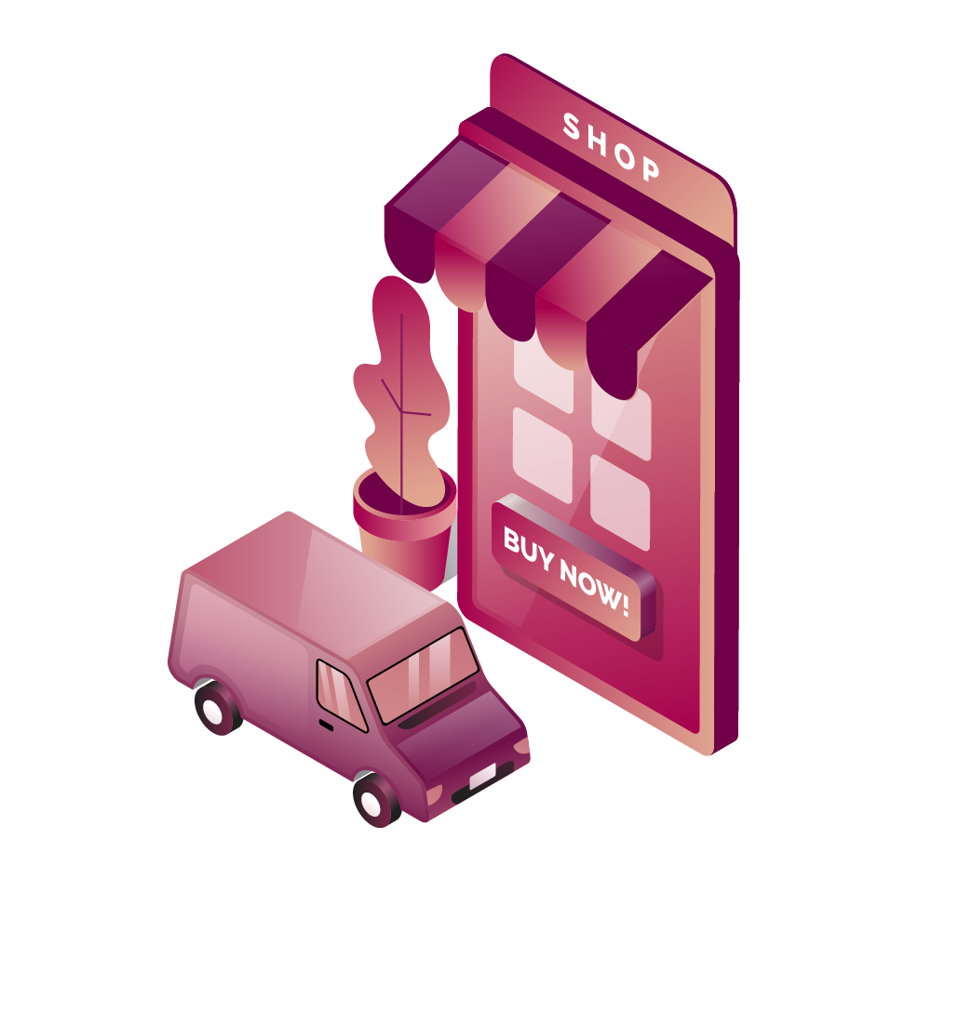
01
Executive Summary & Research Objectives
4
Notes:
Our journey today begins with an executive summary.

Slide 5

Executive Summary
This project delves into the dynamic Brazilian e-commerce market, focusing on Olist, a platform that integrates small businesses into larger online marketplaces.
Utilizing a rich Kaggle dataset alongside Brazil's macroeconomic indicators, including household income, we aim to uncover deep insights into consumer purchasing patterns and market trends.
Our analysis includes a detailed RFM (Recency, Frequency, Monetary) assessment to enhance customer segmentation and purchasing behavior understanding.
The objective is to derive strategic recommendations for Olist, targeting product portfolio optimization, marketing strategies, and overall sales enhancement to solidify their competitive edge in Brazil's flourishing e-commerce sector.
5
Notes:
Our expedition through data has been comprehensive, leveraging a robust Kaggle dataset enriched by Brazil's economic indicators. Our analysis has been meticulous, adopting the RFM methodology to segment customers, thereby sharpening our understanding of their shopping habits. The end goal is to arm Olist with strategies that enhance their product portfolio, elevate marketing precision, and boost sales performance.

Slide 6

Research Objectives
Customer and Sales Data Analysis
Macroeconomic
Integration
Our research aims to conduct a comprehensive analysis of Brazil's e-commerce market, focusing on Olist's operations. Key objectives include:
Examine the Kaggle dataset to decode customer purchasing behaviors, sales trends, and product popularity on Olist.
Assess the impact of Brazil's economic conditions, especially household income, on e-commerce trends.
RFM Analysis
Strategic
Recommendations
Apply RFM modeling for detailed customer segmentation, identifying key groups for targeted marketing.
Formulate actionable strategies for Olist to optimize their product offerings, marketing tactics, and sales strategies, aiming to boost their market position and sales.
6
Notes:
Here’s our reseach objectives, where we've analyzed vast datasets to understand Olist's consumer behaviors and sales trends. Our RFM analysis segments customers, enhancing targeting precision. We've integrated macroeconomic insights, crucial for adapting to market shifts. Our goal is to provide strategic recommendations that propel Olist's market position in dynamic digital marketplace

Slide 7
Business Use Case
Role | Incentive | Business Use
E-Commerce Platform: Olist | Understand purchasing patterns Optimize product recommendation algorithms Improve customer engagement and retention | Use customer behavior data to enhance recommendation engines and personalize shopping experience
Seller | Increase sales revenue Reduce inventory costs Understand product performance | Analyze customer feedback and purchasing trends to optimize stock and improve product listings
Customer | Find products more efficiently Receive personalized recommendations Experience a streamlined shopping process | Leverage data to provide customers with a tailored shopping experience and improve satisfaction
7
Notes:
In this segment, we spotlight the business use case for Olist
For sellers on the platform, the focus is on driving sales and reducing costs. And for our customers, we're leveraging data to transform their shopping journey, making it more efficient, personalized, and satisfying

Slide 8
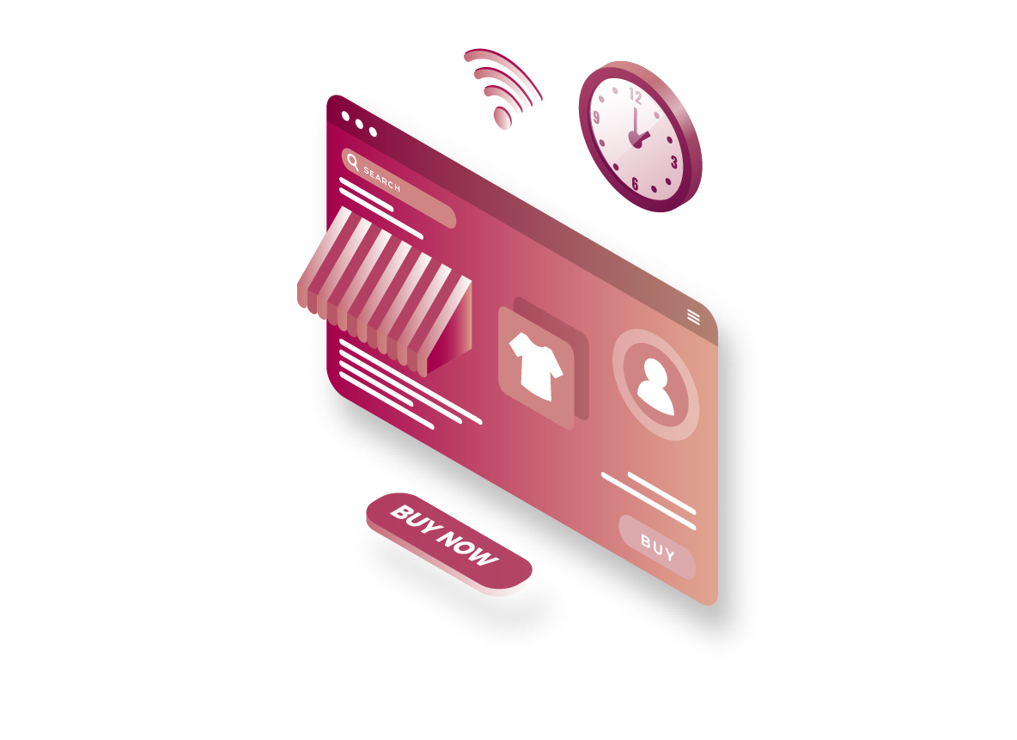
02
Data Ingestion & Preparation
8

Slide 9
Data Profile
Useful Information | Data Size | Rows/Cols
Customers Data: customer id, location | 8.6 MB | 99k / 5
Geolocation Data: zipcode, city, state | 1 MB | 19k / 6
Order Items Data: order, product, seller, shipping | 14.7 MB | 113k / 7
Order Payments Data: payment type and value | 5.5 MB | 104k / 5
Order Reviews Data: review score and comment | 10.9 MB | 99k / 7
Orders Data: order time, status, delivery | 16.1 MB | 99k / 8
Products Data: product profile, category, photo quantity | 2.2 MB | 33k / 9
Sellers Data: seller id, location | 171 KB | 3k / 4
Brazil Macro-economic Data: household income, human develop index, education (state-level) | 2 KB | 27 / 6
9

Slide 10










Tools for Data Processing
Data Ingestion
ETL Process
Data Warehouse
Analytics & Modeling
Visualization
Insights Reporting
10

Slide 11

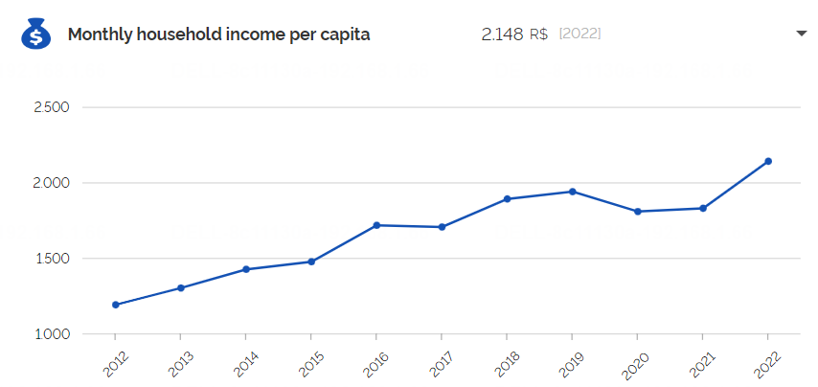



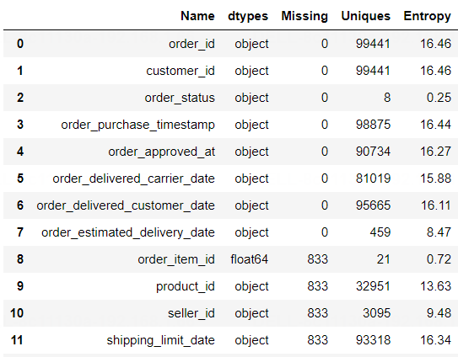
Data Ingestion
Web Scraping
Brazilian state-level macro-economic data
E-Commerce Data: Public Dataset by Olist
Tables connected by foreign keys
Snapshot of Column Profile
Data types, missing value, entropy of each column
11

Slide 12
ETL – Process & Details
The Process
Cleaning & Transformation
Olist Data | Brazilian State-Level Macro-Economic Data
Removed emojis in customer review for loading into database | Calculated the annual average HDI, monthly household income, etc. for the years 2016-2018 (the time span of the dataset)
Supplemented missing zipcodes, cities and states (0.84% of rows) from post-code.org | Indexed all the attributes with State Abbreviations, for connecting Olist dataset
Translated product categories from Portuguese to English | Total of 27 records for all states in Brazil
Unified datetime format as yyyy/m/d hh:mm:ss
Recoded all missing datetime values as ‘1900/1/1 00:00:00’
Olist Dataset
Treated Abnormal & Missing Values
Recoded
the Data
Cleaned
Data
12

Slide 13

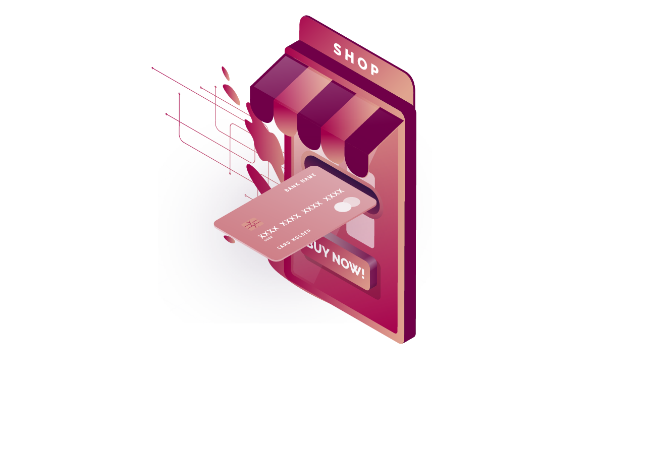
03
Data Modeling & Design
13

Slide 14




Database Design Consideration
Database Modeling
OLTP: Normalized physical entity-relationship model
OLAP: Multi-dimensional snowflake model
Data Types
Choose VARCHAR datatypes for primary keys and other string attributes
Define Date attributes with datatypes DATETIME or TIMESTAMP
Follow standard naming convention for attributes
Granularity of Data
E-commerce data is atomic in nature and can be stored in a fact table and rolled up by month/quarter
Data Integrity
Establish a unique primary key for each entity/table
Set foreign key relationships and constraints (not null, unique)
Define default values for missing values wherever applicable (e.g. -1 for INT, None for VARCHAR)
14

Slide 15
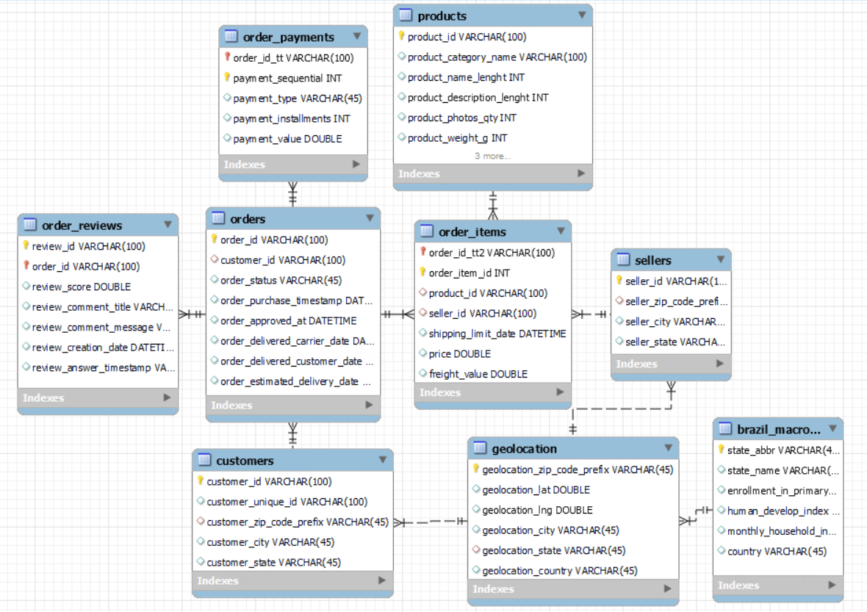
EER Diagram
15

Slide 16
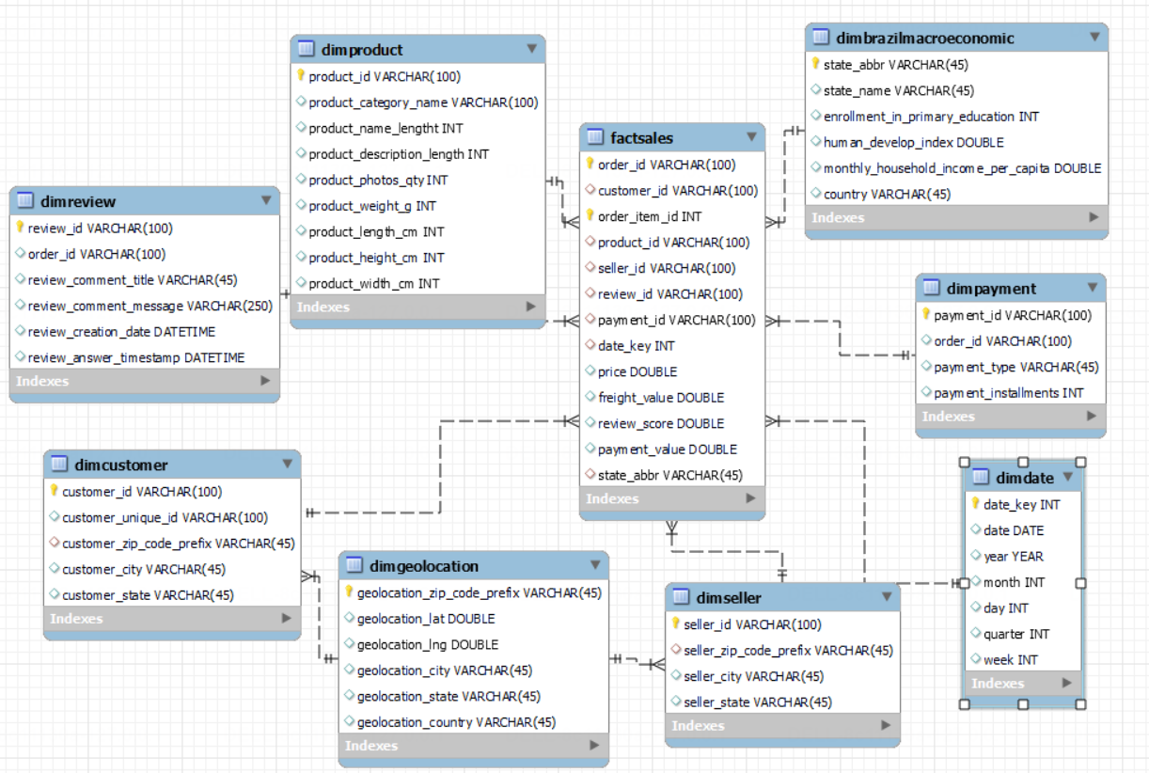
Snowflake Schema
16

Slide 17

Data Quality Dimension
Completeness: Missing values in all look-up tables are specially treated
Validity: Data format and types conform to the defined business rules and constraints
Uniqueness: No duplicates or redundant entries in all tables
Consistency: Dimensions and data types are consistent across tables and two schemas
Timeliness: Data represent reality in time as data is from relatively recent period
Accuracy: Data is aggregated by summing and averaging over locations and dates, and this transformation can represent reality
17

Slide 18
04
Insights
18

Slide 19
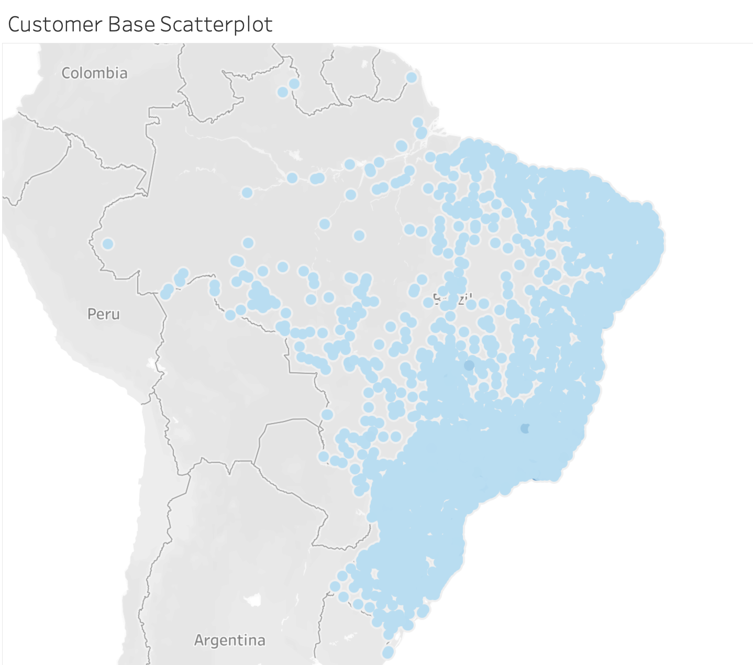
Demographics
Most Customers Locate in South
SP has 42% of Customers
SP's significant customer share offers an opportunity for localized marketing campaigns, tailored events, and regional product launches
19
Notes:
This slide show the demographic and how this data is shaping our strategic initiative
On the left, The concentration of points clearly shows that a significant portion of our customers are located in the southern regions, highlighting a key area of engagement and opportunity for our business.
Now, if we shift our focus to the right, we delve deeper into specifics with a state-by-state breakdown. Here, we can see that Sao Paulo stands out distinctly with the largest customer base, comprising 42% of our customers. That tells us where we should focus our marketing efforts, customer service enhancements, and potentially, our next physical storefront.
Additionally, Understanding the density and distribution of our customers doesn't only help us serve them better—it allows us to predict market trends, customize our product offerings, and localize our services to resonate deeply with the cultural and regional preferences.

Slide 20
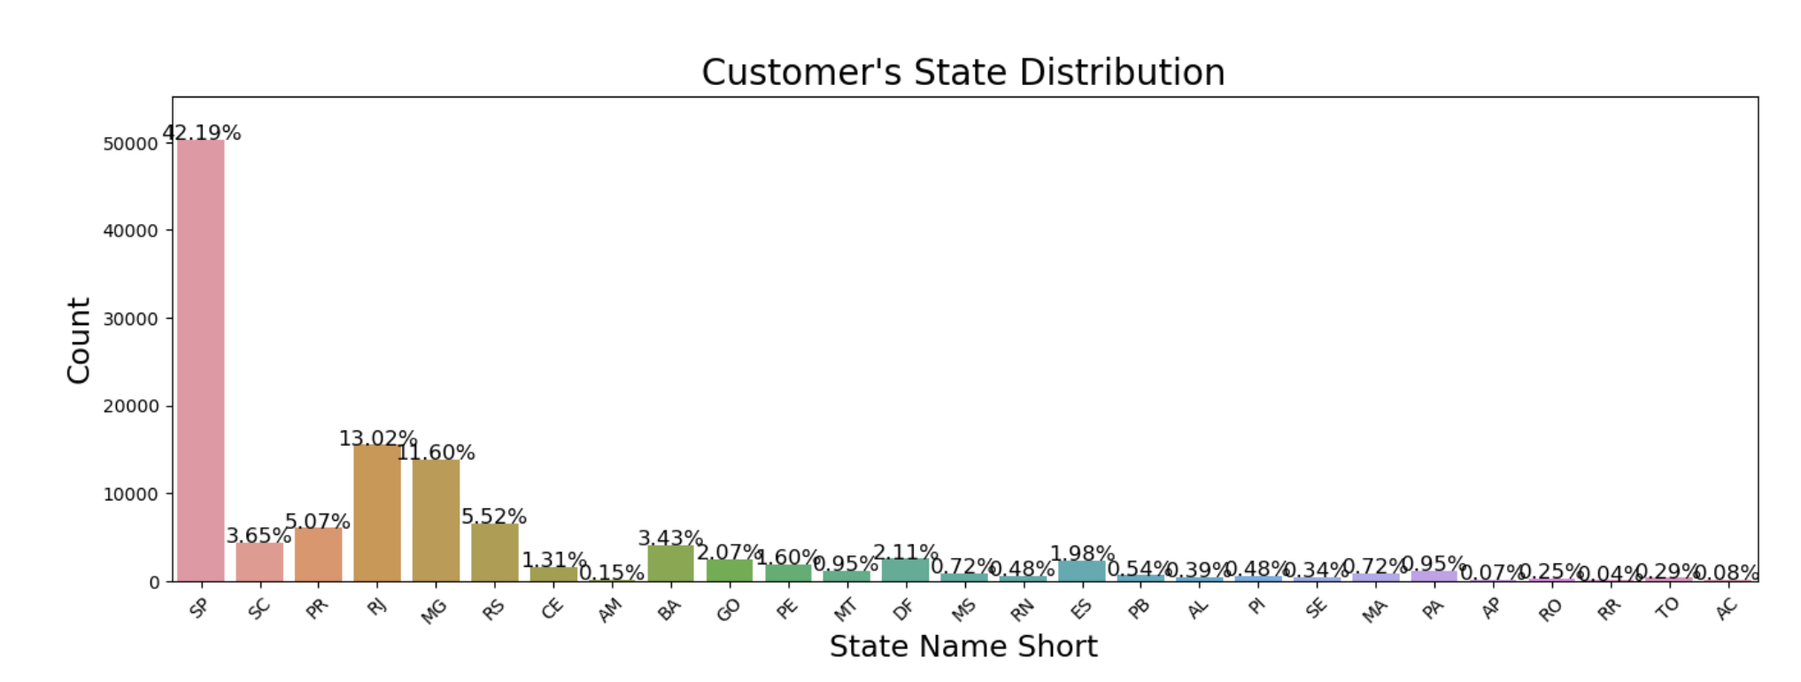
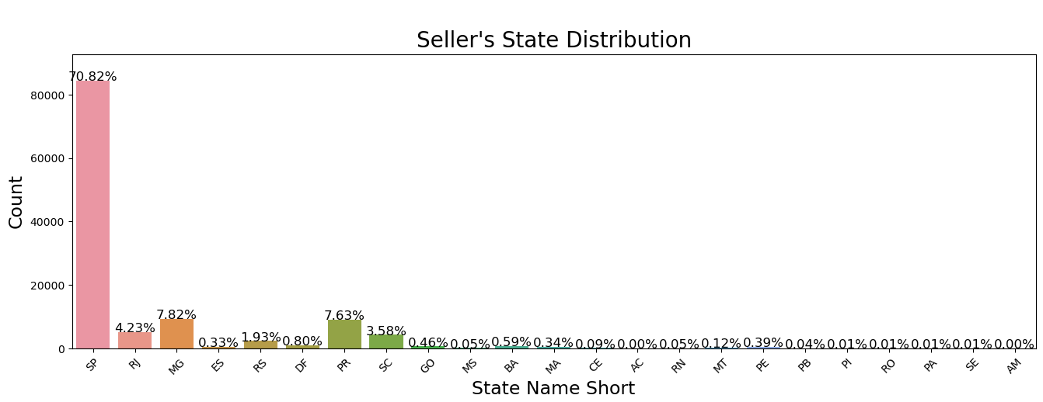
of
SP's massive share of both sellers and customers makes it the heart of our commercial operations
~42% of Customers Based in SP
Strong regional presence
Explore regional preferences to tailor marketing strategies and product development
~71% of Sellers Based in SP
Robust supply chain efficiencies and Potential for logistics optimization
Leverage SP's dense market to pilot new services due to the high engagement potential
20
Notes:
Our first chart shows that Sao Paulo is not just a state; it's the beating heart of our customer base with over 42% residing within its bounds. It shows the trust and preference that customers in Sao Paulo have in our services and offerings.
The second chart echoes this sentiment from the supply side, where an 70% of our sellers in Sao Paulo. This geographic clustering is more than convenient—it's a strategic advantage that has allowed us to streamline our supply chains and optimize delivery mechanisms to a degree of efficiency.
The implications of these figures are profound. we not only continue to nurture this fertile market but also use it as a testbed for innovation.

Slide 21
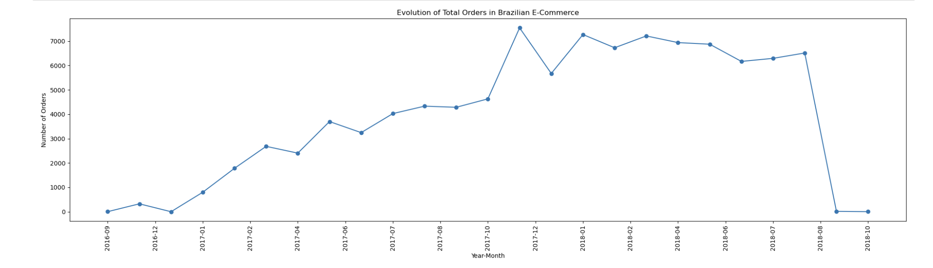
Evolution of Orders Overtime
Differentiated growth patterns and the market's regional diversity
The varied growth rates across different regions underscore the necessity for region-specific strategies to capitalize on high-growth areas and support lagging regions
21
Notes:
By the chart above we can conclude:
E-commerce on Brazil really has a growing trend along the time. We can see some seasonality with peaks at specific months, but in general we can see clear that customers are more prone to buy things online than before.
Monday are the prefered day for brazilian's customers and they tend to buy more at afternoon

Slide 22
05
Analysis & Recommendations
22

Slide 23
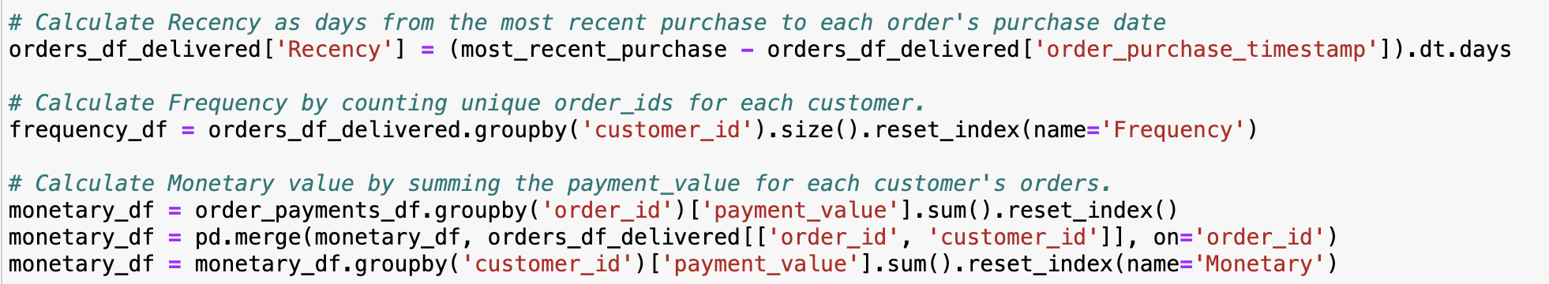
RFM Analysis
RFM Analysis
Filter data to contain only orders that is delivered
Recency: Days from the most recent purchase to each order's purchase date
Frequency: Total number of unique transactions of each customer
Monetary: Total transaction value of each customer
Recency
Frequency
Monetary Value
The freshness of customer activity
The frequency of customer transaction
The intention of customer to spend
23
Notes:
our RFM Analysis, which is a cornerstone of our customer value approach for Olist. RFM stands for Recency, Frequency, and Monetary value. Recency tells us how recent the last purchase was, giving us insight into the customer's engagement level. Frequency shows us how often a customer shops, indicating their loyalty. Lastly, Monetary value indicates the total spend, helping us know the customer's value. Our data is filtered to reflect only completed orders, ensuring a precise analysis. We've used Python to calculate these metrics, allowing us to segment customers effectively and strategize accordingly."

Slide 24
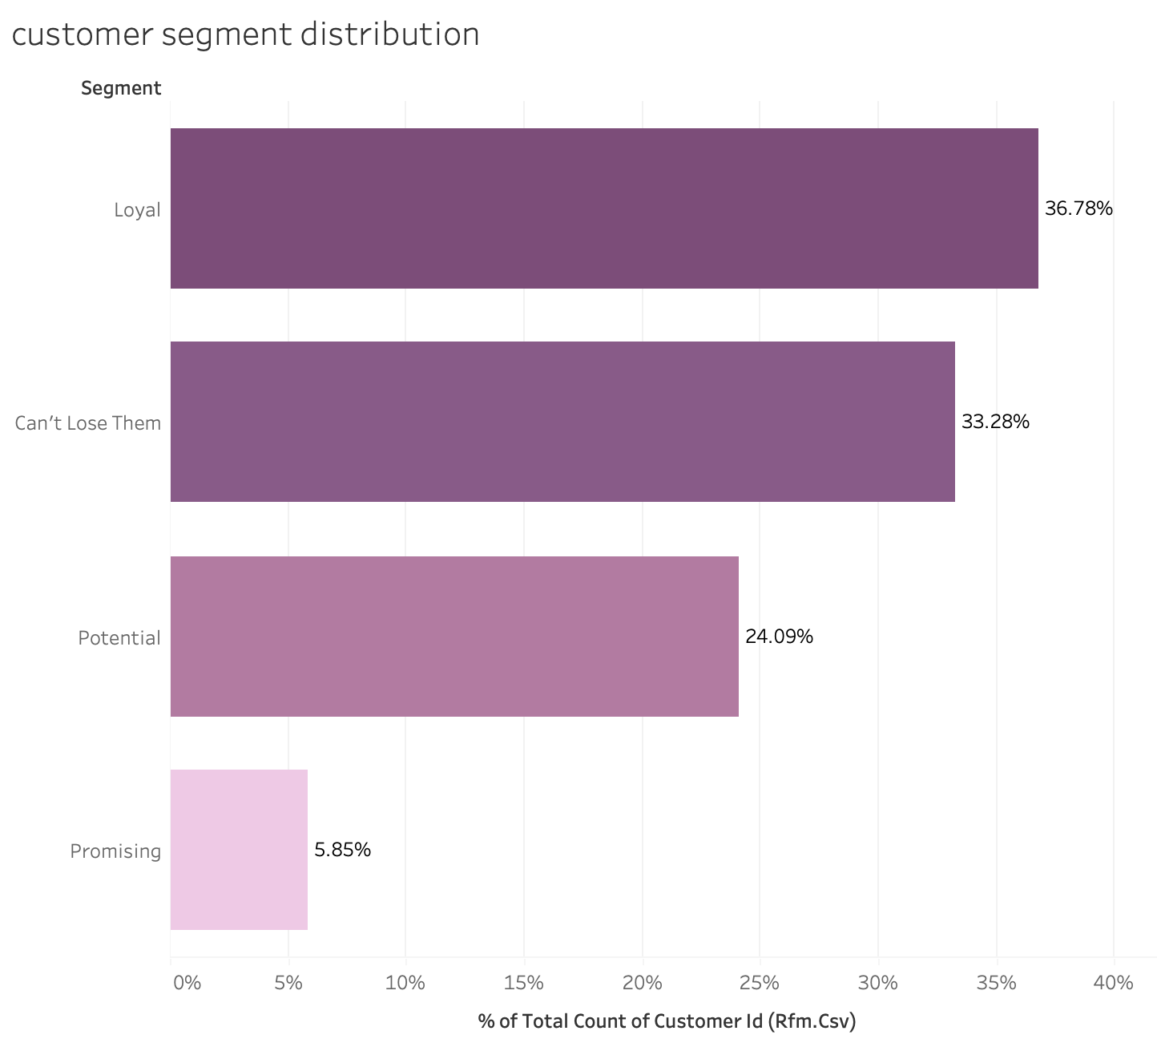
Customer Segmentations
Customer Profile | Recency | Frequency | Monetary | RFM Score
Can’t Lose Them | High | High | High | >9
Loyal | High | Moderate | Moderate | [7,9)
Potential Loyalists | Moderate | Moderate | Moderate | [5,7)
Promising | Low | Low | Low | [3,5)
Fairly solid customer base
With ~70% customers show their loyalty to the website
Recommendation strategy needed
Stimulate potential loyal customer’s purchase
24
Notes:
"Moving to customer segmentation, we've identified key groups within Olist's customer base. Our segments range from 'Can't Lose Them,' our most engaged and high-spending customers, to 'Promising,' who are recent but lower in frequency and spend. Particularly, we see a substantial 'Potential' segment, making up 24% of our base. These customers, with moderate RFM scores, show promise for increased loyalty and spending. Our strategy here focuses on converting this potential into loyal customers through targeted marketing and personalized engagement."

Slide 25
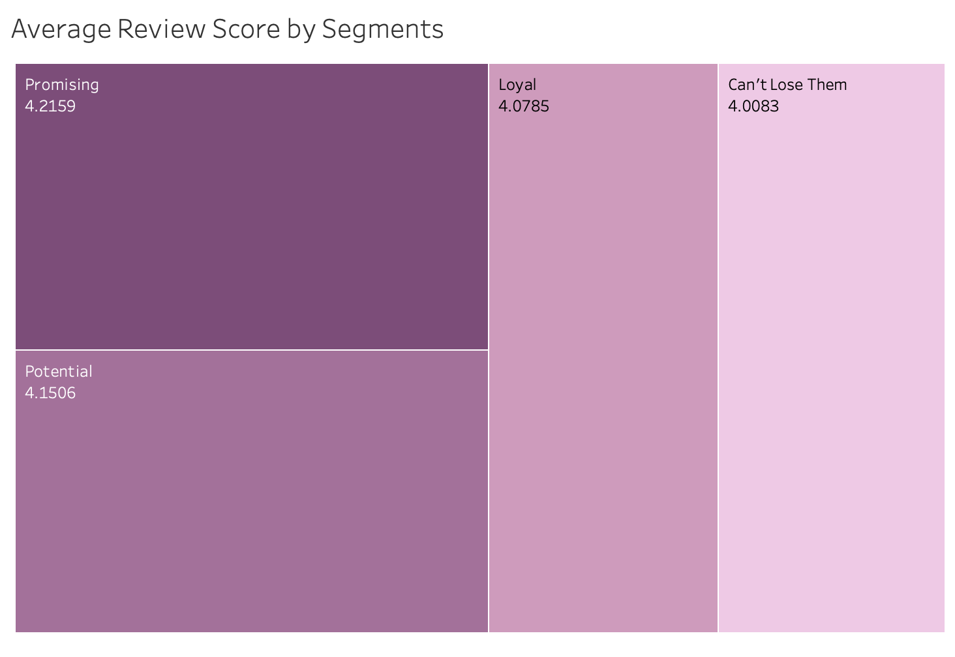
Incentive Paired with Segmentations
Most loyal customer segmentation has the lowest average review score
Strategy for this segmentation:
Seek feedback on products and services to show company value their opinion.
Offer exclusive loyalty programs or VIP status.
Provide early access to new products or sales.
25
Notes:
"Each segment warrants a tailored approach. For example, our most loyal customers surprisingly have the lowest average review scores. This tells us there's an opportunity to enhance their satisfaction. We aim to do this by soliciting feedback, showing we value their opinion, and by offering exclusive loyalty programs or VIP status. Such initiatives not only acknowledge their importance but also encourage continued engagement and spending."

Slide 26
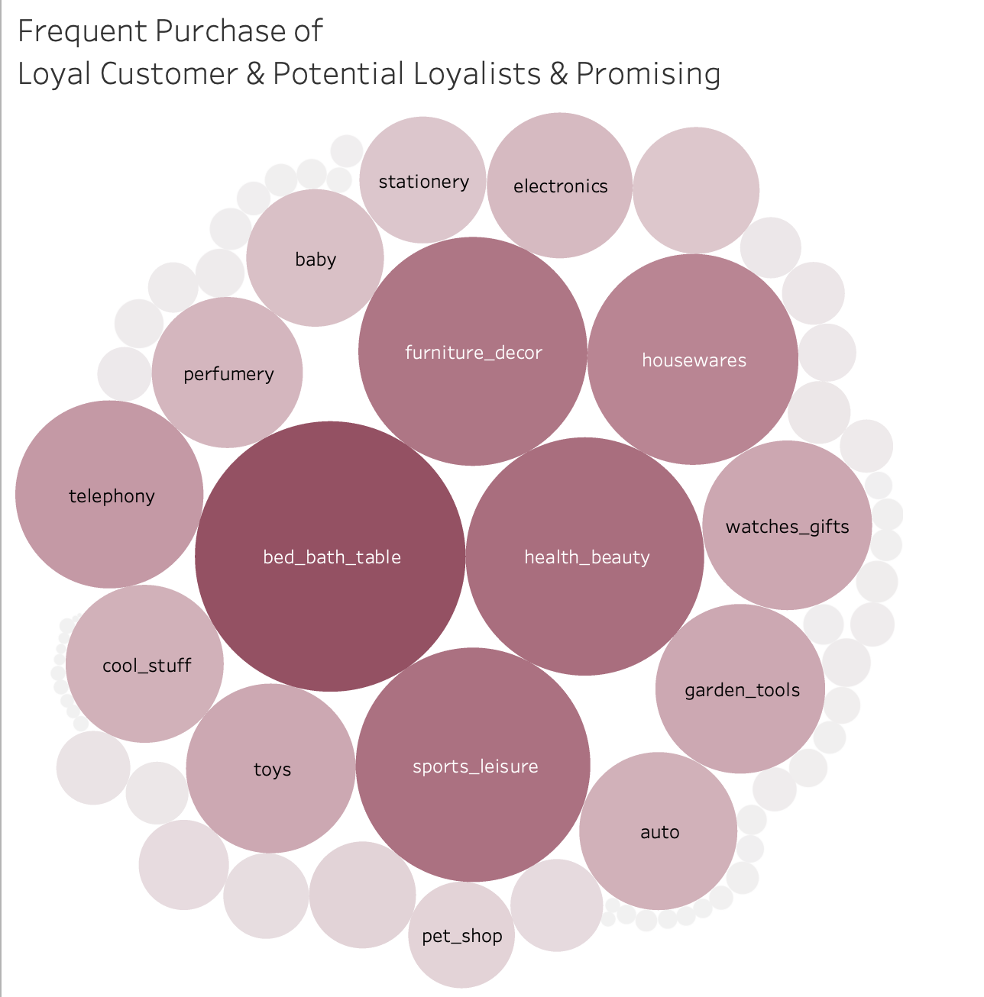
Incentive Paired with Segmentations
Strategy for Loyal & Potential Loyal & Promising Loyal Customers:
Offer loyalty discounts or rewards for frequent purchases. (e.g. furniture décor, bed&bath, sports, etc..)
Engage with personalized email campaigns that showcase products similar to their previous purchases.
26
Notes:
"Finally, we look at the purchase behavior of our 'Loyal' and 'Promising' segments. We've noted that certain categories like furniture, bed & bath, and sports see more frequent purchases. This insight is pivotal. We'll tailor our incentives, such as loyalty discounts or rewards, around these categories. Additionally, we plan to roll out personalized email campaigns, showcasing products similar to past purchases, to reinforce the connection between customer interests and our offerings. This strategy is designed to enhance customer retention and increase sales."

Slide 27


06
Future Work & Preliminary Plan
27

Slide 28
Preliminary Plan
Request New Data of Customer Demographics
Develop Collaborative Filtering for Recommendation Engine
Deliver Recommendation Engine
Week 1
Week 2-3
Week 4-6
Week 7-10
March
Data Analysis and Modeling
A/B Testing and Evaluate Customer Feedback
28

Slide 29
Future Work & Lessons Learned
The customer segmentation can be more accurate with additional data on customer demographics, e.g., age, race, sex, income level, etc..
Recommendations can be more accurate with the utilization of a collaborative filtering method, which would recommend a similar product that is bought by similar customers.
Considering the scalability and data structure, we should also implement NoSQL to cope with larger data volume and unstructured elements (e.g., customer reviews, product descriptions).
Regular cleanup should be conducted to archive old and used data, which can help manage the growth of attributes.
29

Slide 30
References
State-level macro-economic data from the Brazilian Institute of Geography and Statistics: https://www.ibge.gov.br/en/cities-and-states/sp.html
Olist Store official website: https://olist.com/
Public e-commerce data from Olist Store: https://www.kaggle.com/datasets/olistbr/brazilian-ecommerce/data
Most valued e-commerce and direct-to-consumer unicorns in Brazil as of October. (2022) https://www.statista.com/statistics/1282103/highest-valued-e-commerce-startup-companies-brazil/
Leading unicorn companies based on market value in Latin America. (2023) https://www.statista.com/statistics/1028116/latin-america-unicorn-companies-market-value/
30

Slide 31

THANKS

Slide 32
Appendix

Slide 33
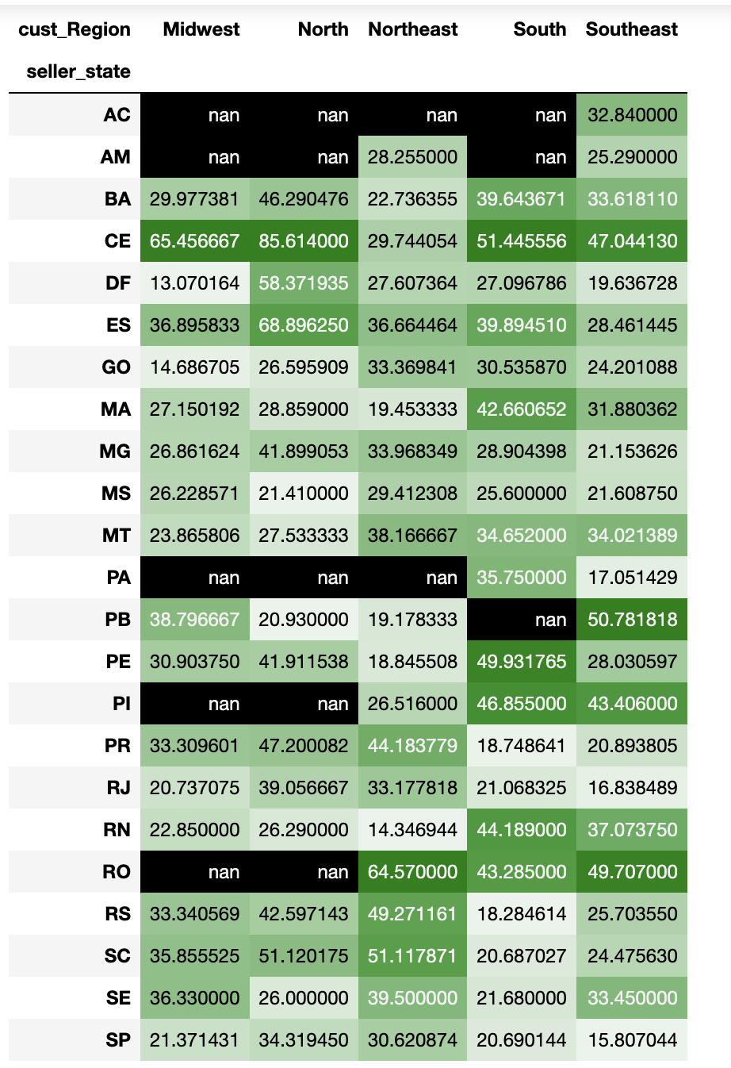



Freight Value mean from State to Regions

Slide 34
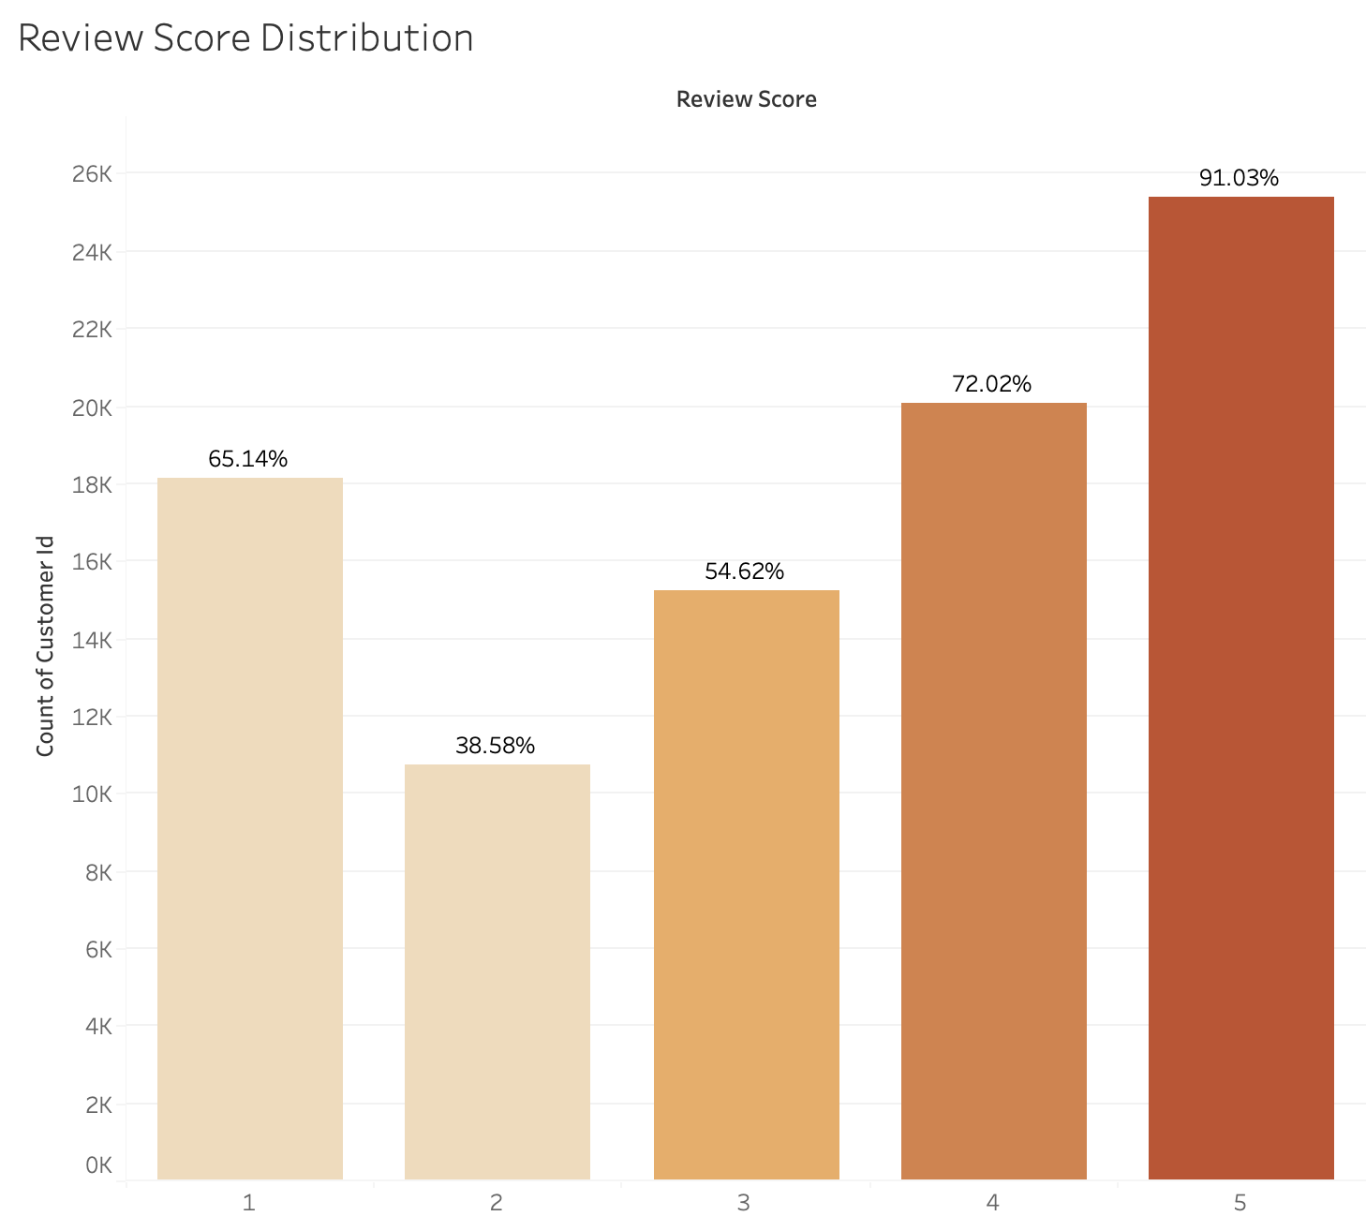
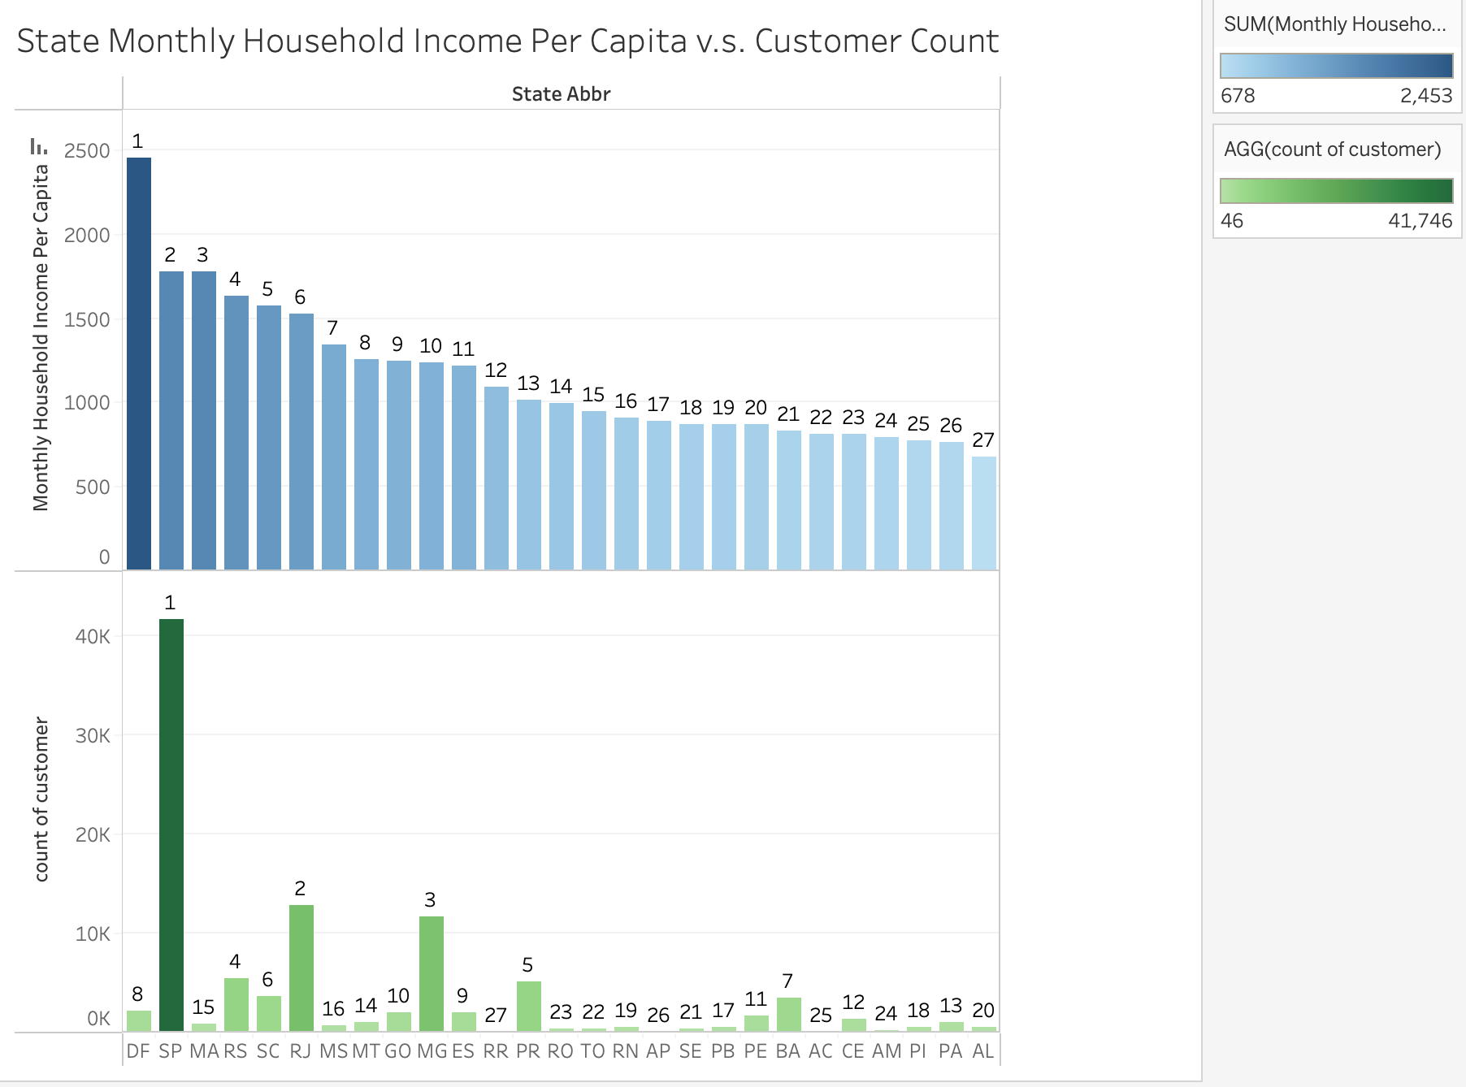
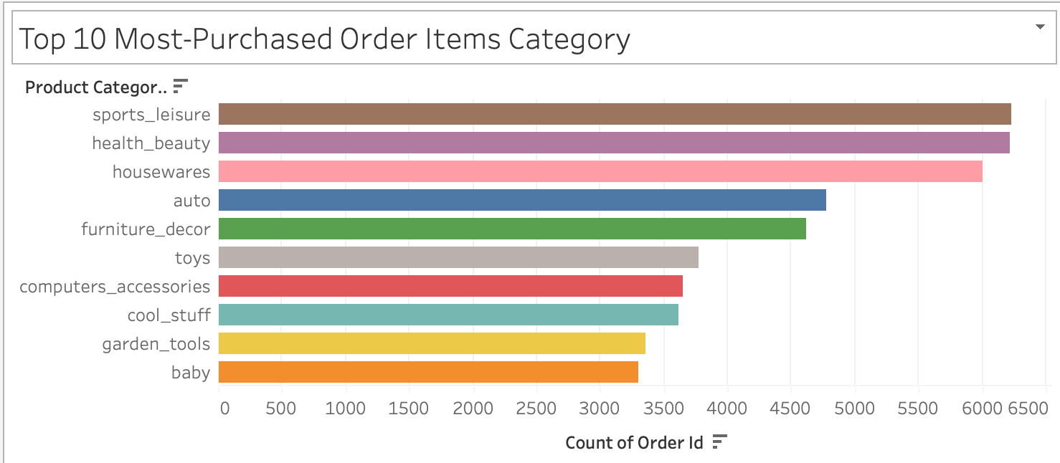

Slide 35
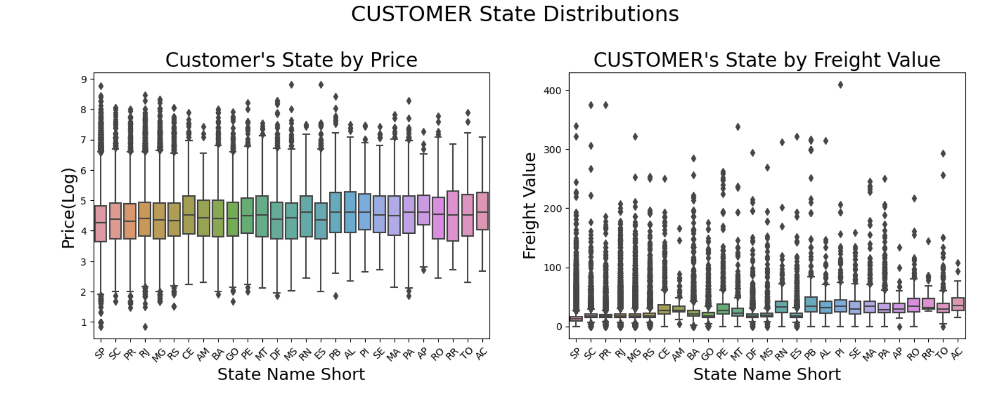
We can see that the most common state of CUSTOMERS is SP(42.19%), followed by RJ(13.02%) and MG(11.6%).
All this states is from the southeast region of Brazil. Also, we have many sales to RS, PR,
SC (states from south region)

Slide 36
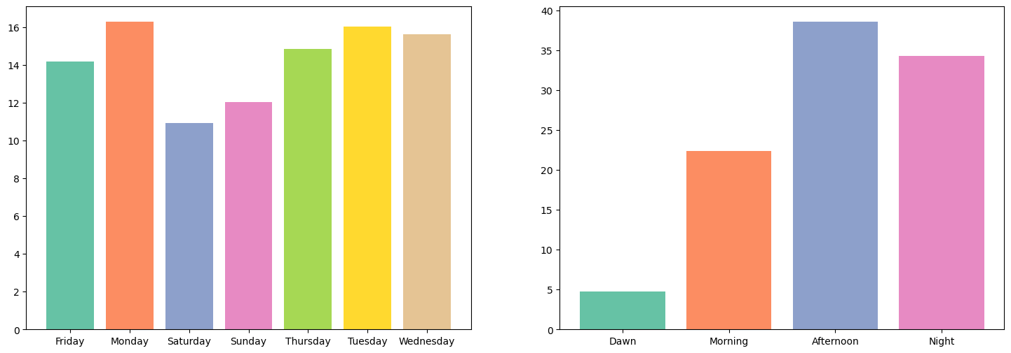
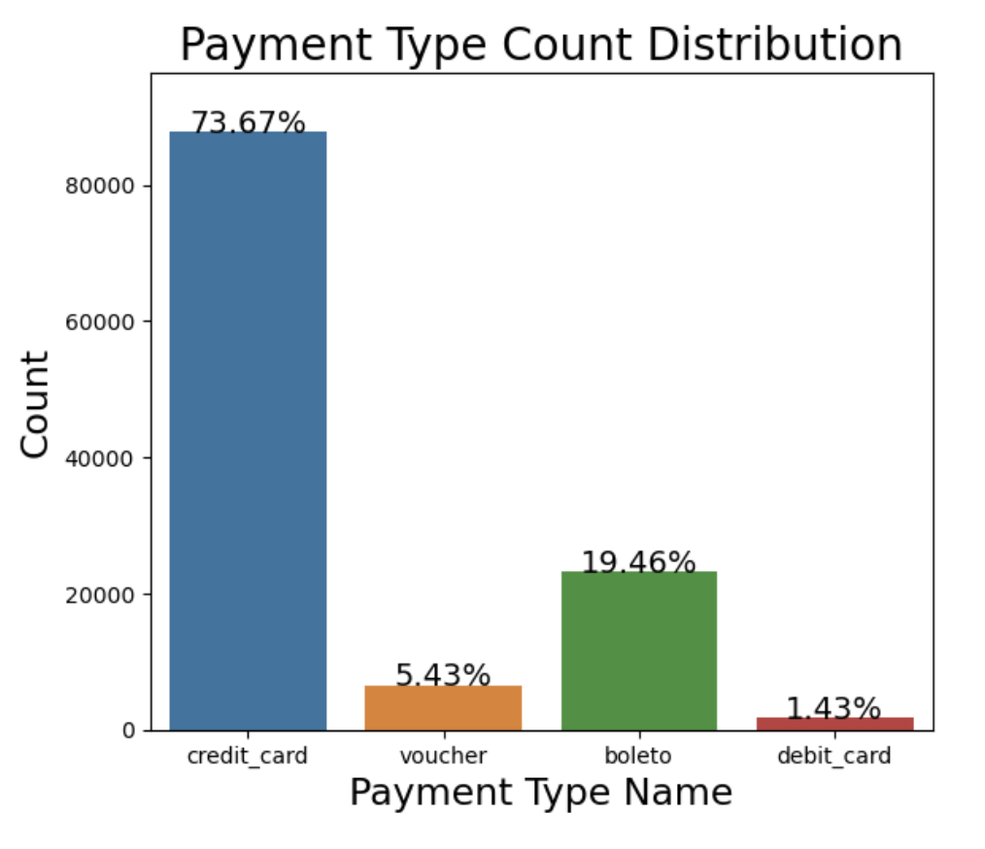
Orders by Day of Week
Payment Type Distribution with Value Labeled
Orders by Time of Day
Notes:
1. Is there any growing trend on brazilian e-commerce?
2. On what day of week brazilians customers tend to do online purchasing?
3. What time brazilians customers tend do buy (Dawn, Morning, Afternoon or Night)?
More than 73.5% of all sales are the Payment type is Credit Card.
Second most common Payment Type is "boleto"(invoice) with almost 19.5%.
The third more common payment type is voucher with 5.43%.
We also have some payments from debit card and only 3 sales to not_defined

